Slide 1

Soloing MMORPG Development as a Programmer
Kevin Daniel Setiono Snob Entertainment UG

Slide 2

Kevin Daniel Setiono
24+ years software development
10+ years professionally
2 years for Microsoft
Founder Snob Entertainment UG
Freelancer (Enterprise Development)
Open Source MMORPG https://github.com/KDSBest/2D-MMORPG-Youtube
Youtube Channel KDSBest GameDev https://www.youtube.com/c/KDSBestGameDev
Slides and Demos https://github.com/KDSBest/DevCom2022/

Slide 3
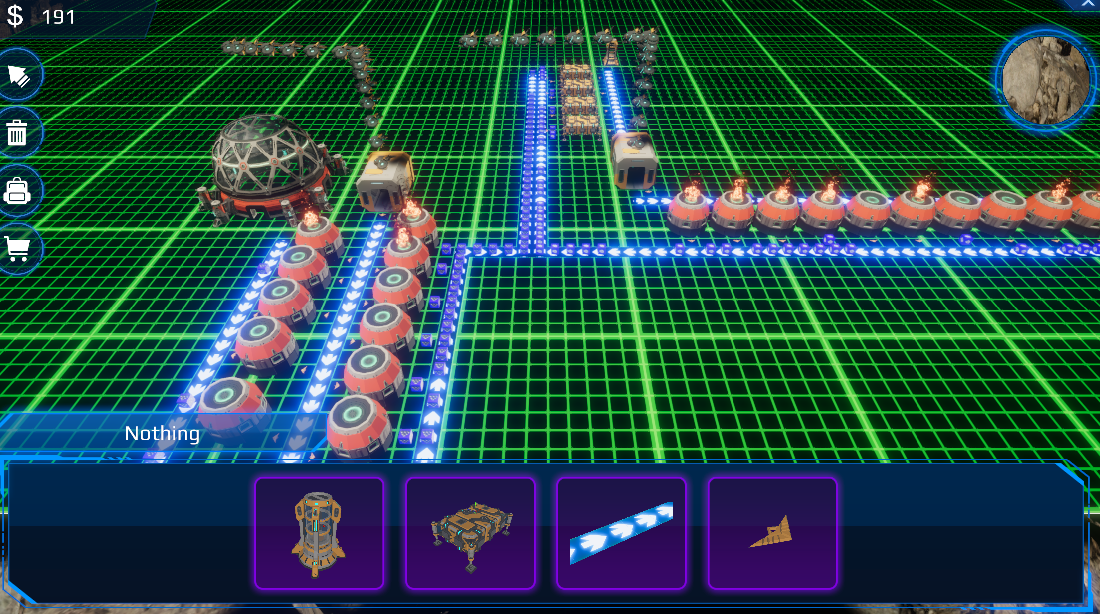
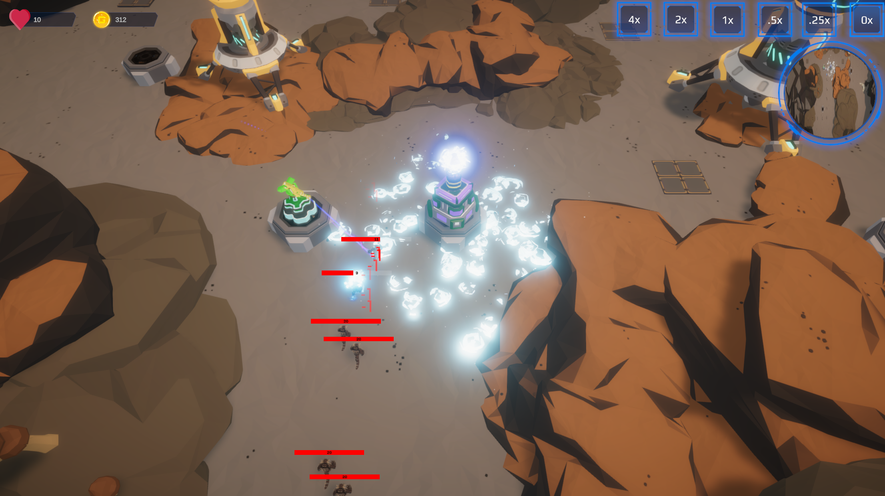

SNOB Entertainment UG (haftungsbeschränkt)
Project Astra Dominium

Slide 4
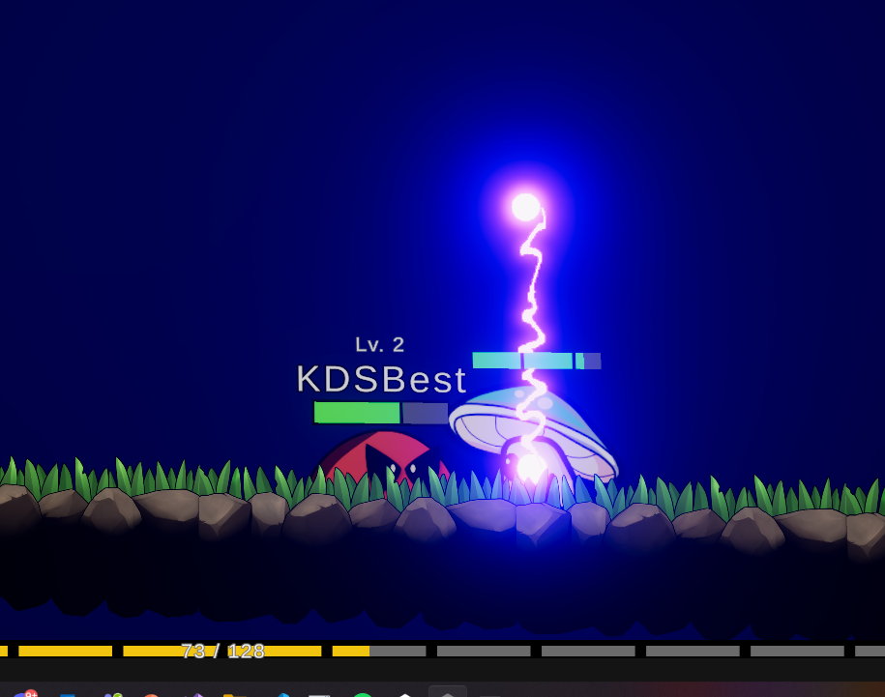
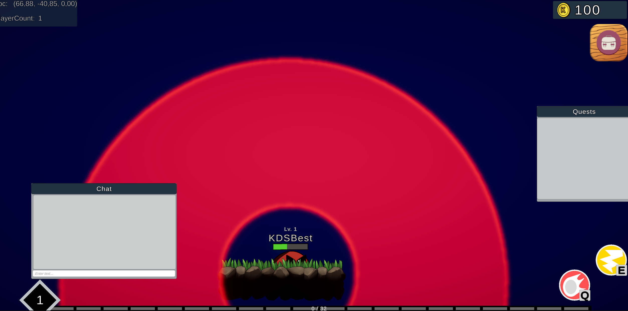
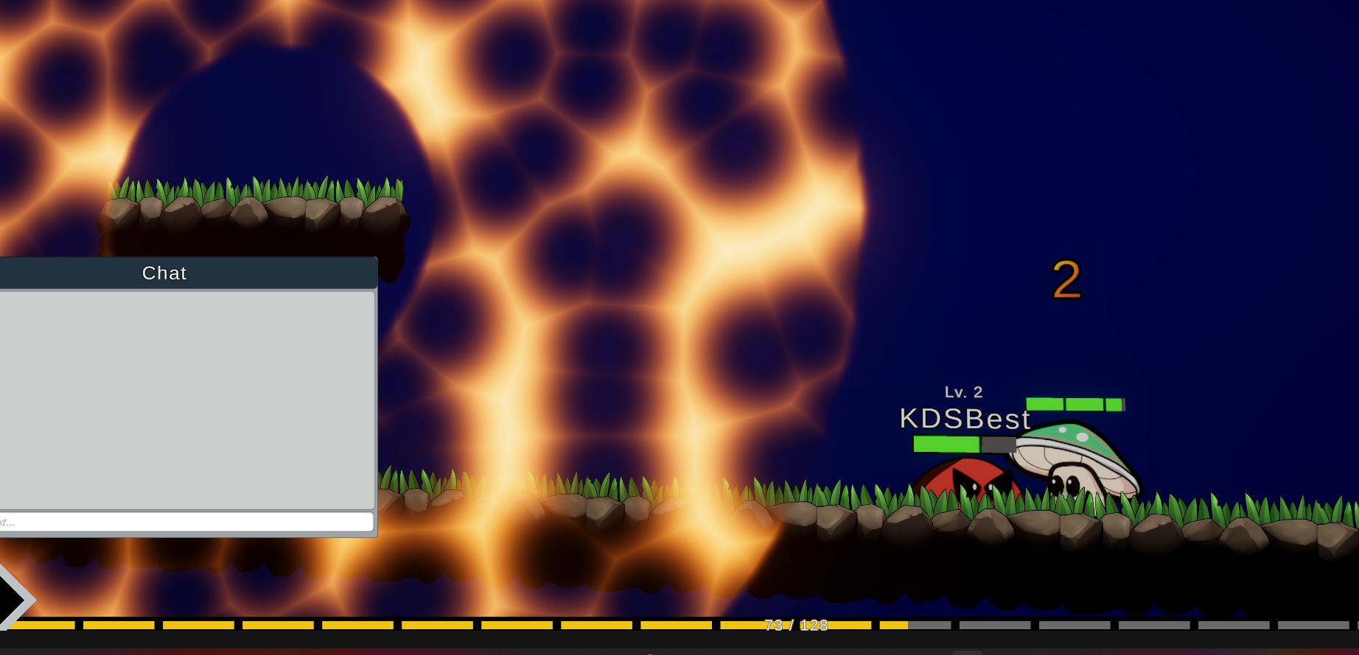
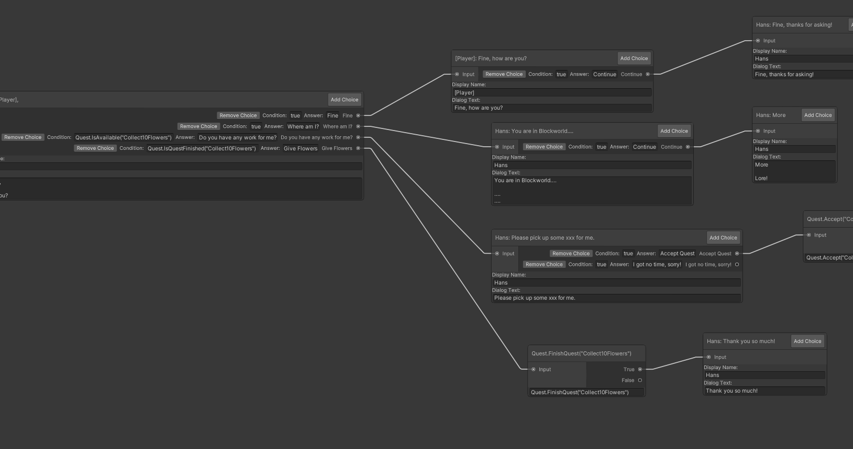
Open Source MMORPG

Slide 5
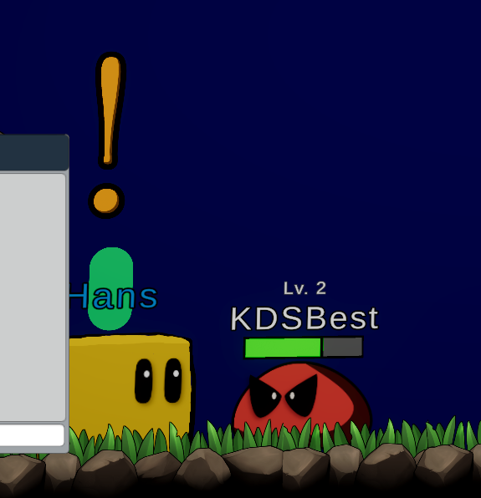
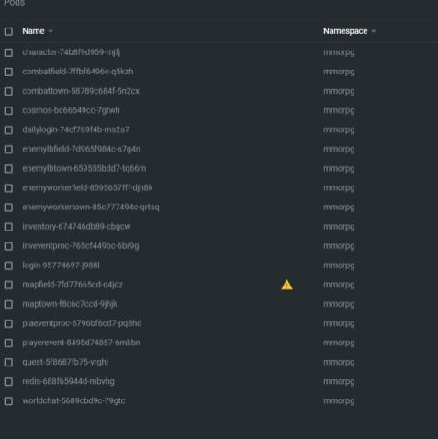
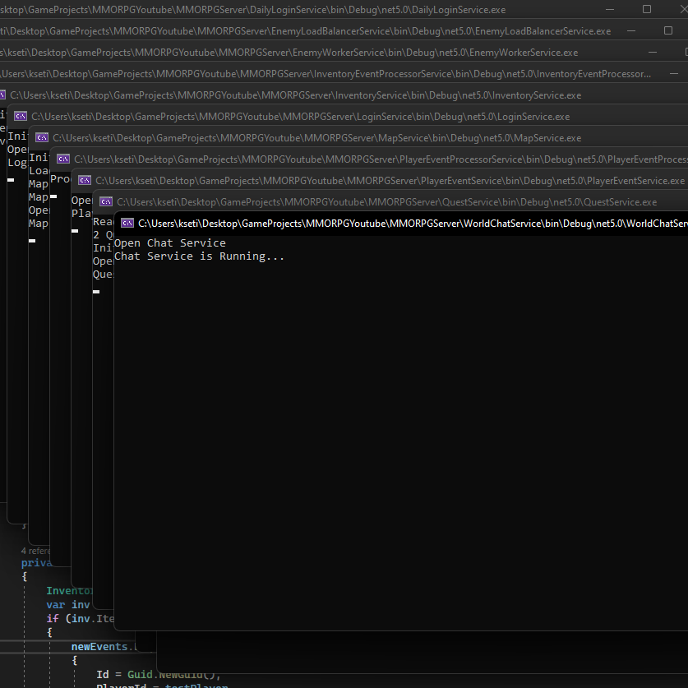
Agenda
How does it scale?
Engine or no Engine
Pub/Sub
Partitioning/Sharding
Fan Out (World Chat)
Eventual Consistency (Inventory)
Map Realtime Data

Slide 6

How does it scale?
Chuck Norris doesn’t have disk latency because the hard drive knows to hurry the hell up.

Slide 7
Scalable
User
Isolated per Player Login Service
Match/Lobby
Isolated to a small group of Player Guild Chat
Map Section
Isolated per Map Section
Map Data
Map
Singleton
All Player want the same Information
World Chat, News
Isolated per Map
Shout Chat.

Slide 8
Pain-O-Meter
Login Service
Player (isolation): Delay is fine IO: NoSQL DB – with Document per Player
Private Chat
Guild (isolation) or Player(isolation): Delay is fine Scales: Fan Out to per Player IO: NoSQL DB – Document per Guild or Player or None
Map (isolation): Delay is fine
Map Data
Map Section (isolation):
Shout Chat
ASAP
IO: Ufff…
Snapshots maybe?
Scales: Fan Out to per Player
IO: None

Slide 9
Engine or No Engine
Why do hardcore raiders smell? Because they never wipe.

Slide 10

I need to simulate physics on the server

Slide 11
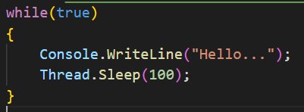
Code – No Engine

Slide 12
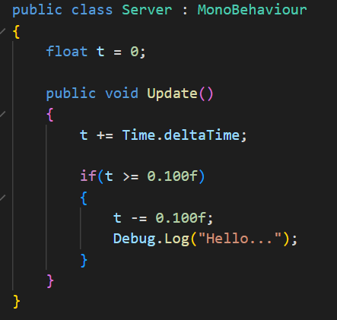
Code – Engine (Only One Empty GameObject With the Component)

Slide 13
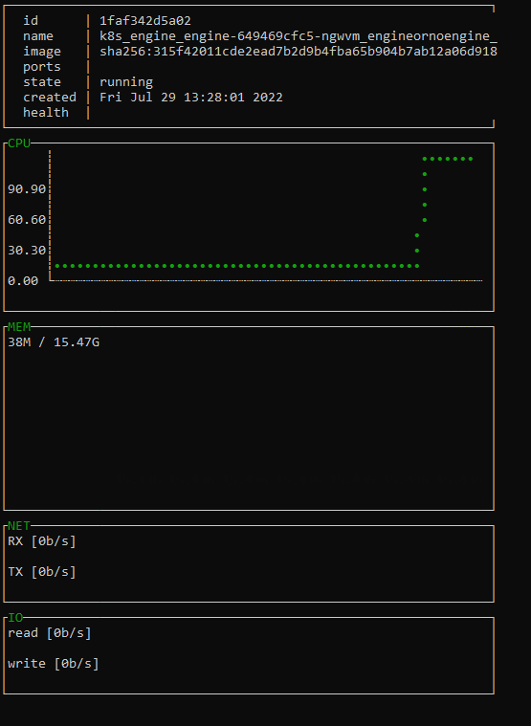
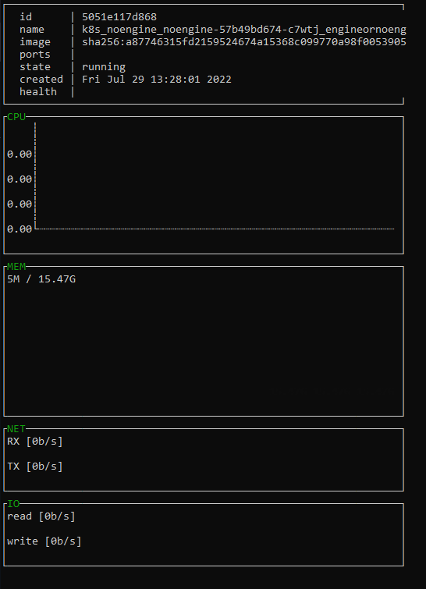

Metrics
Engine
No Engine

Slide 14
Pub/Sub
Algorithm
Word used by programmers when… they don’t want to explain what they did.

Slide 15
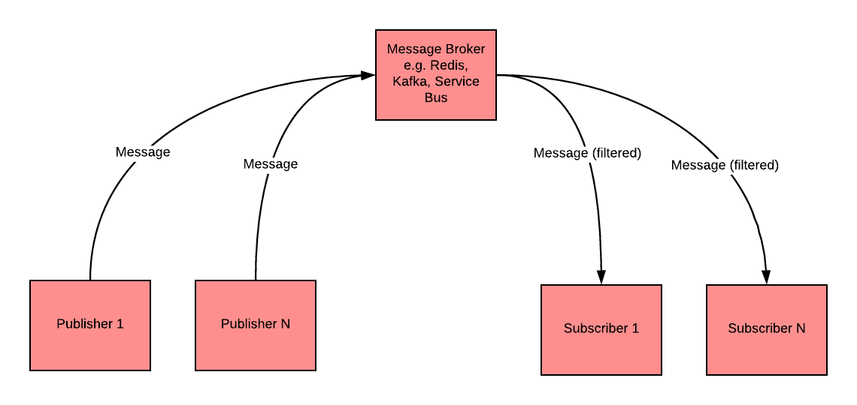
What is Pub/Sub?
Loose Coupling
Publisher doesn’t even know the existence of Subscribers
Scalable
Message Delivery Issues
e.g. if subscriber is not listening

Slide 16
Is it a good idea?
Player Position send via Pub/Sub?
Player to Player Trading item transfer via Pub/Sub?
Enemy dies and gives player exp via Pub/Sub?

Slide 17
Partitioning/ Sharding
3 Database Admins walked into a NoSQL bar. A little later, they walked out because they couldn’t find a table.

Slide 18
Logical and Physical Partitions CosmosDB
Logical Partition
Splits Data into groups
Partition Key
< 20GB size
Physical Partition
Hardware
Max 10.000 RU/s
Runs at least one Logical Partition

Slide 19
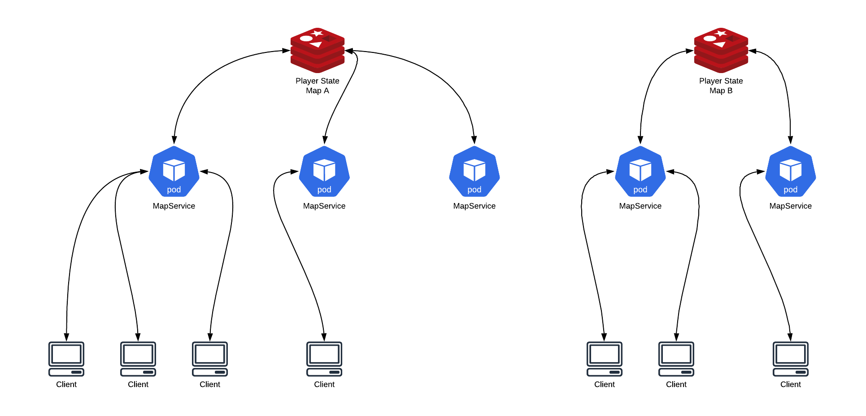
Sharding Redis

Slide 20
Fan-Out (World Chat)
How many programmers does it take to change a light bulb? None, because it is a hardware problem.

Slide 21
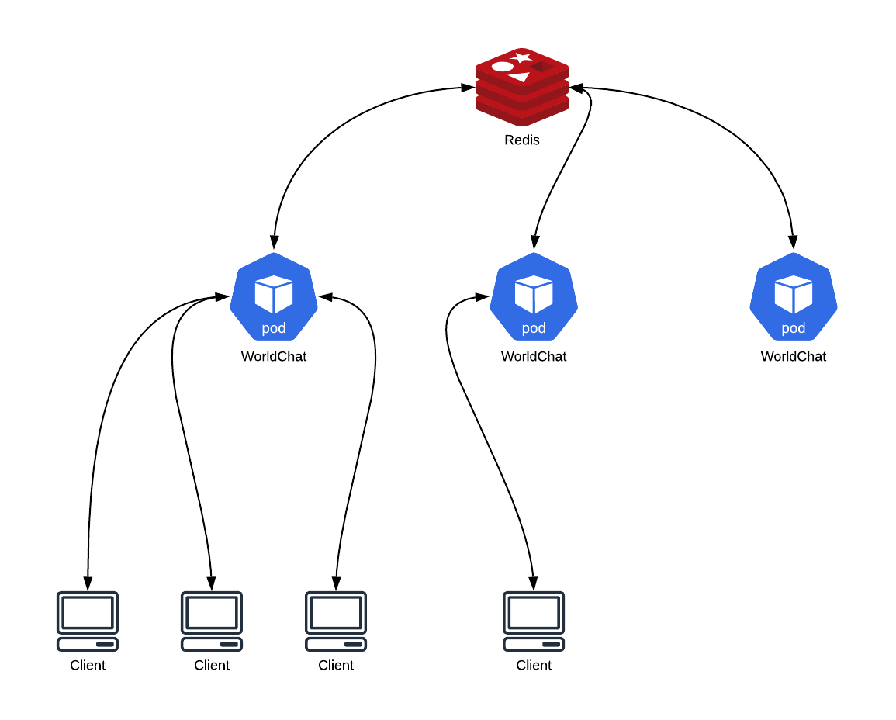
World Chat Scaling with Fan-Out

Slide 22
Eventual Consistency (Inventory)
I have an eventual consistency joke, it's hilarious! Either you get it right away or maybe later!

Slide 23
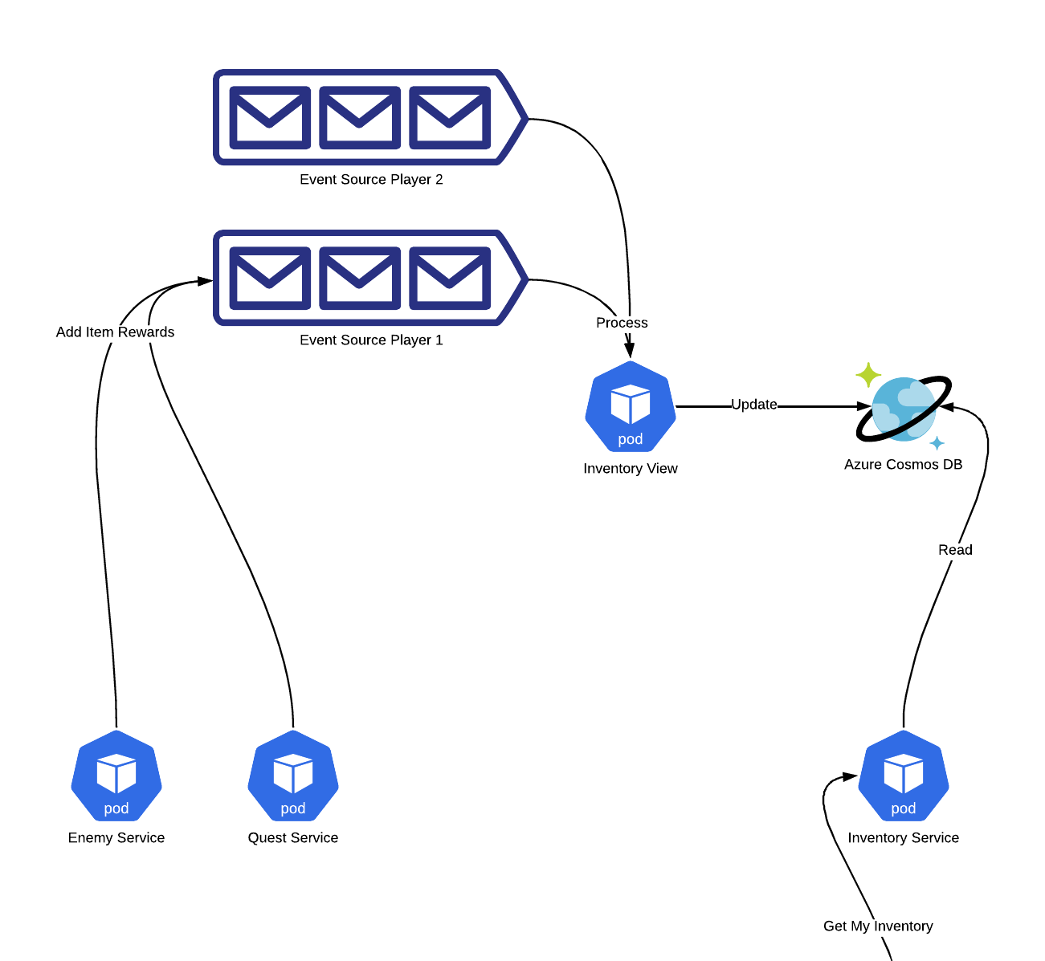
Adding Stuff is fine

Slide 24
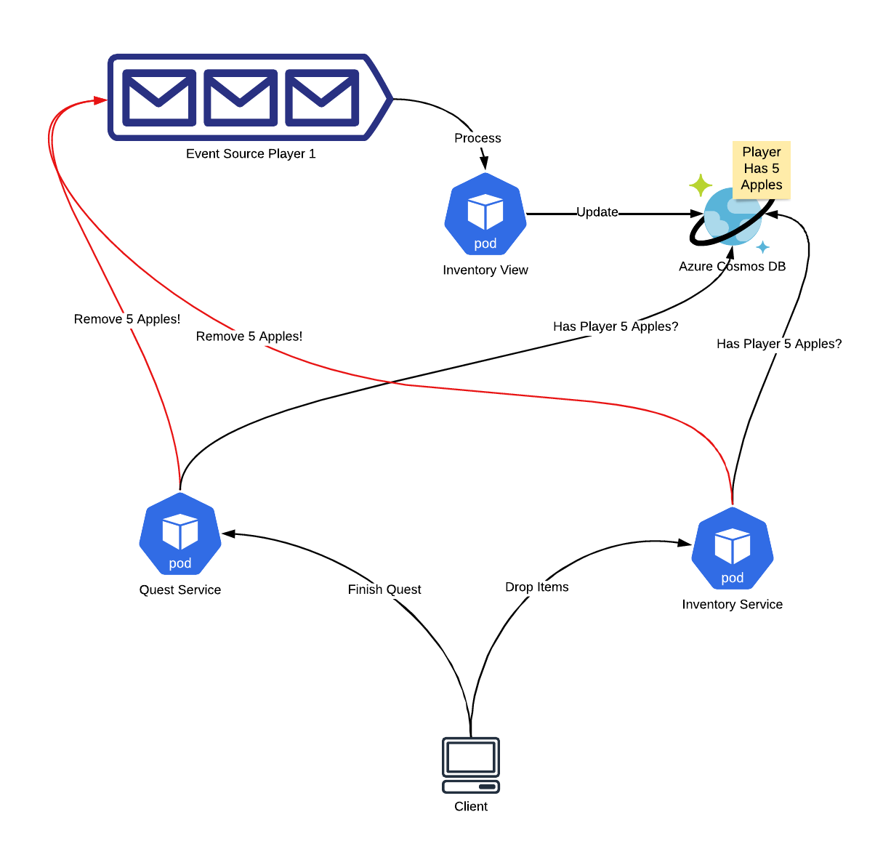
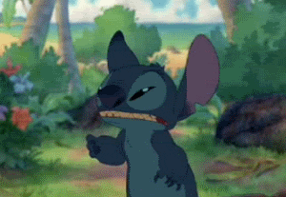
Removing is tricky. Player Drops Items and Finishes Quest at the same time. I love eventual consistency

Slide 25
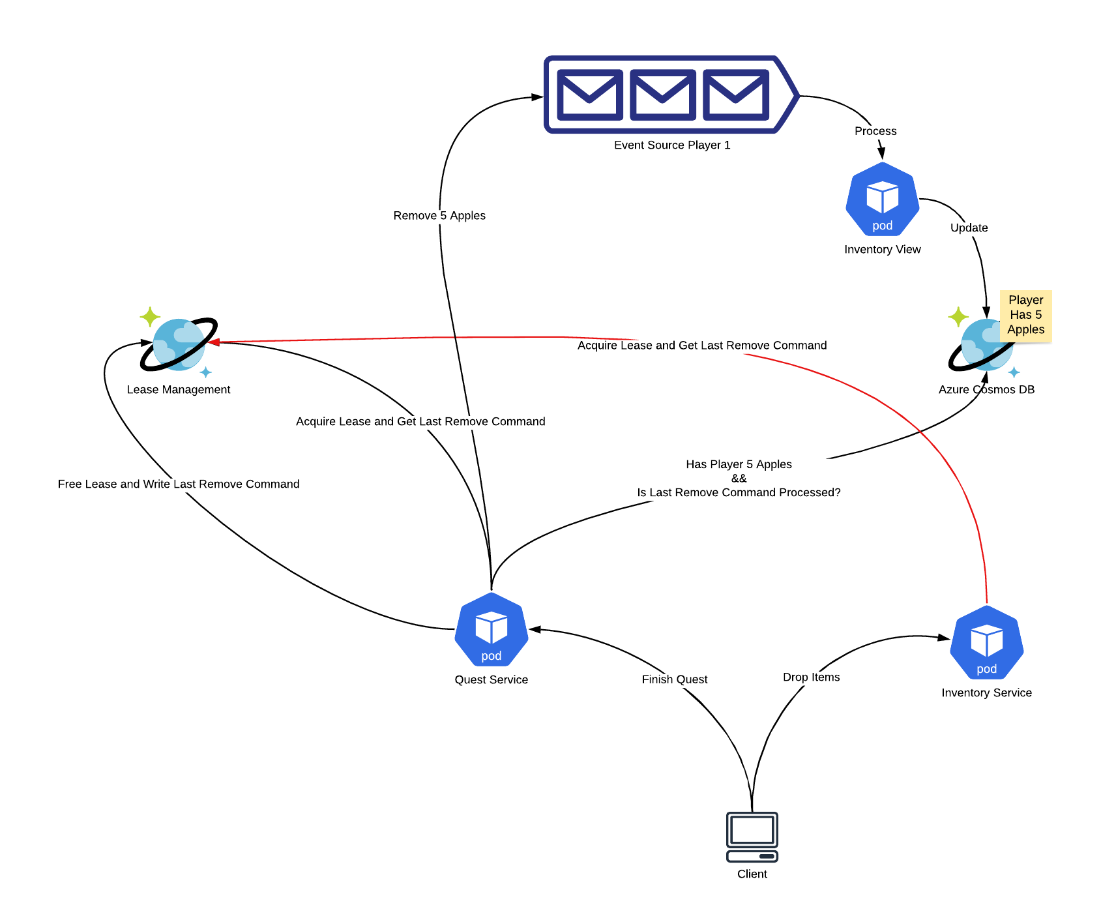

Getting Consistency in Eventual Consistency for Remove

Slide 26
MMORPG Map
There are only two hard problems in distributed systems:
2. Exactly-once delivery
1. Guaranteed order of messages
2. Exactly-once delivery

Slide 27
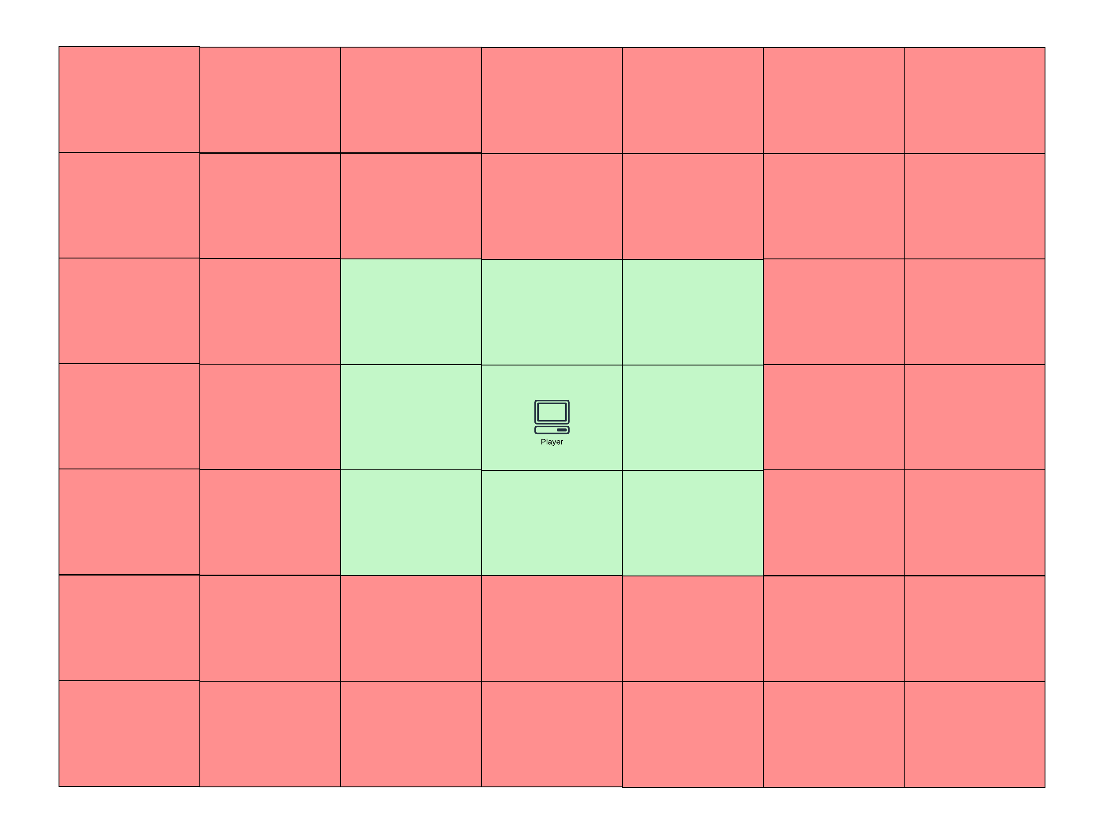
Map Registration Algorithm

Slide 28
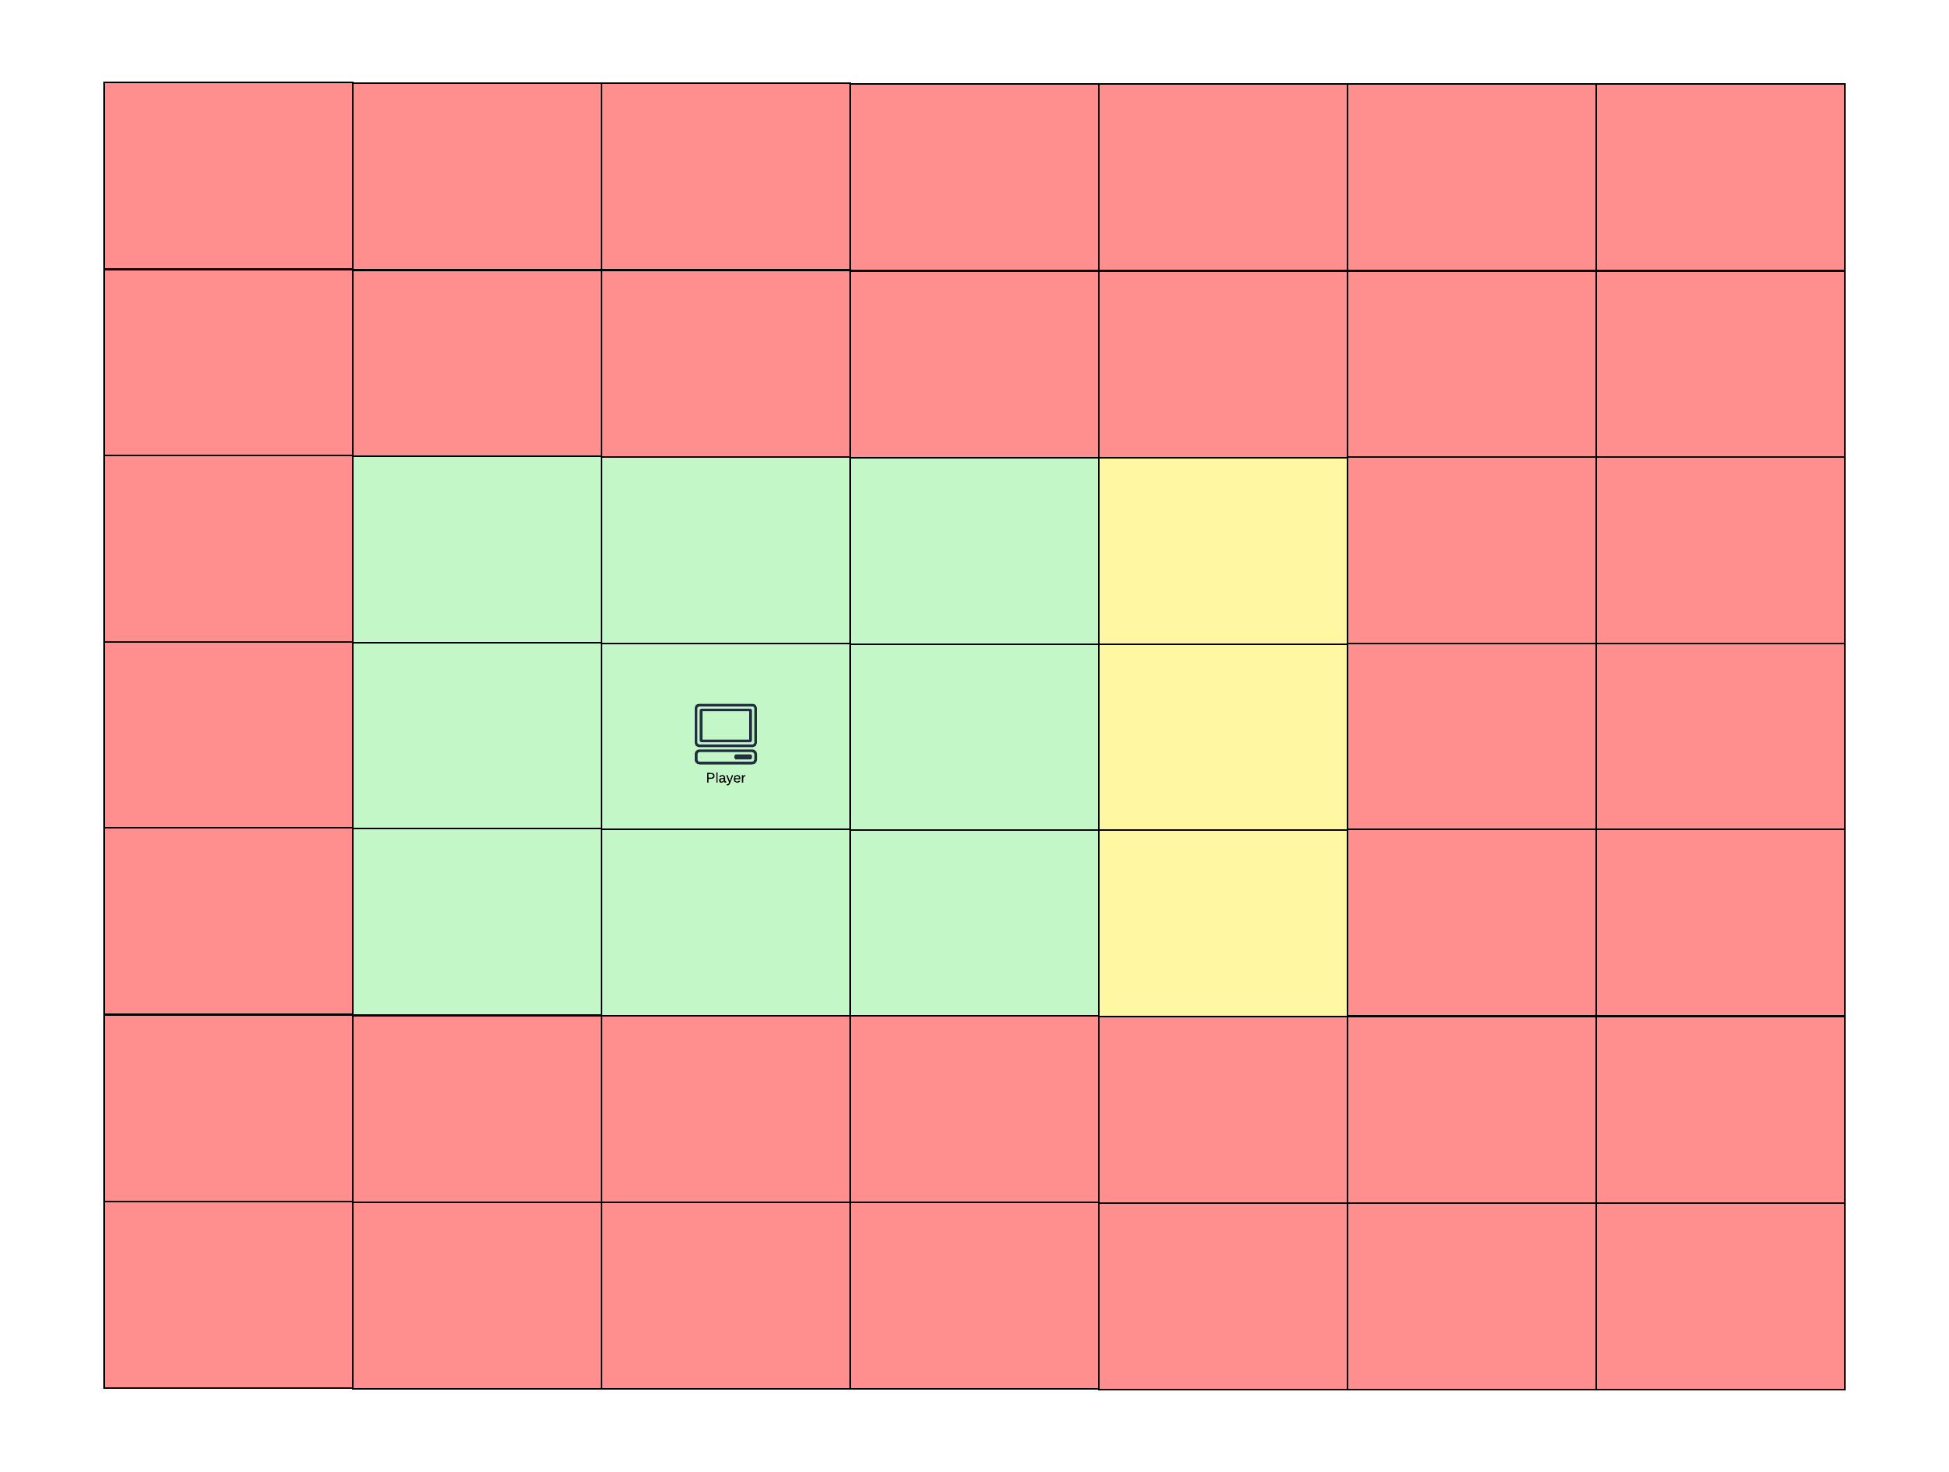
Map Registration Algorithm

Slide 29
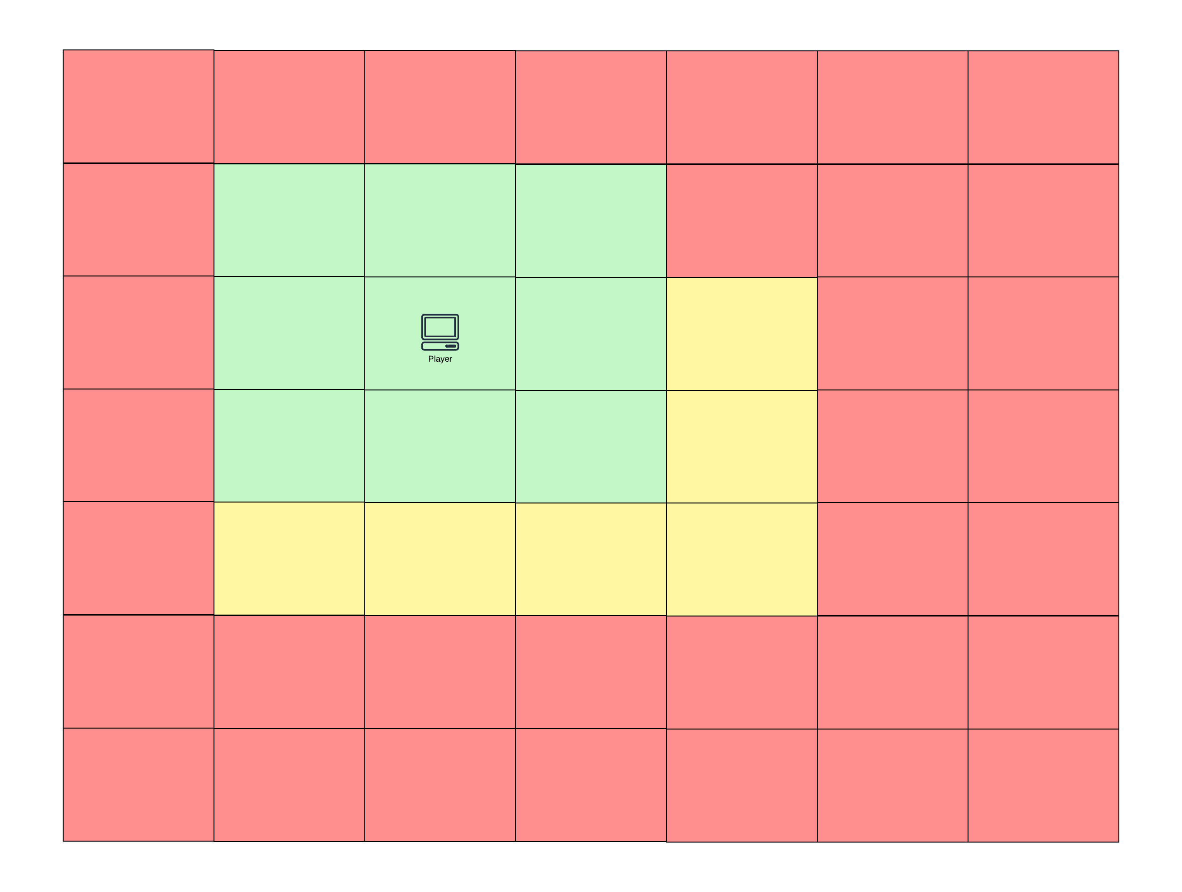
Map Registration Algorithm

Slide 30
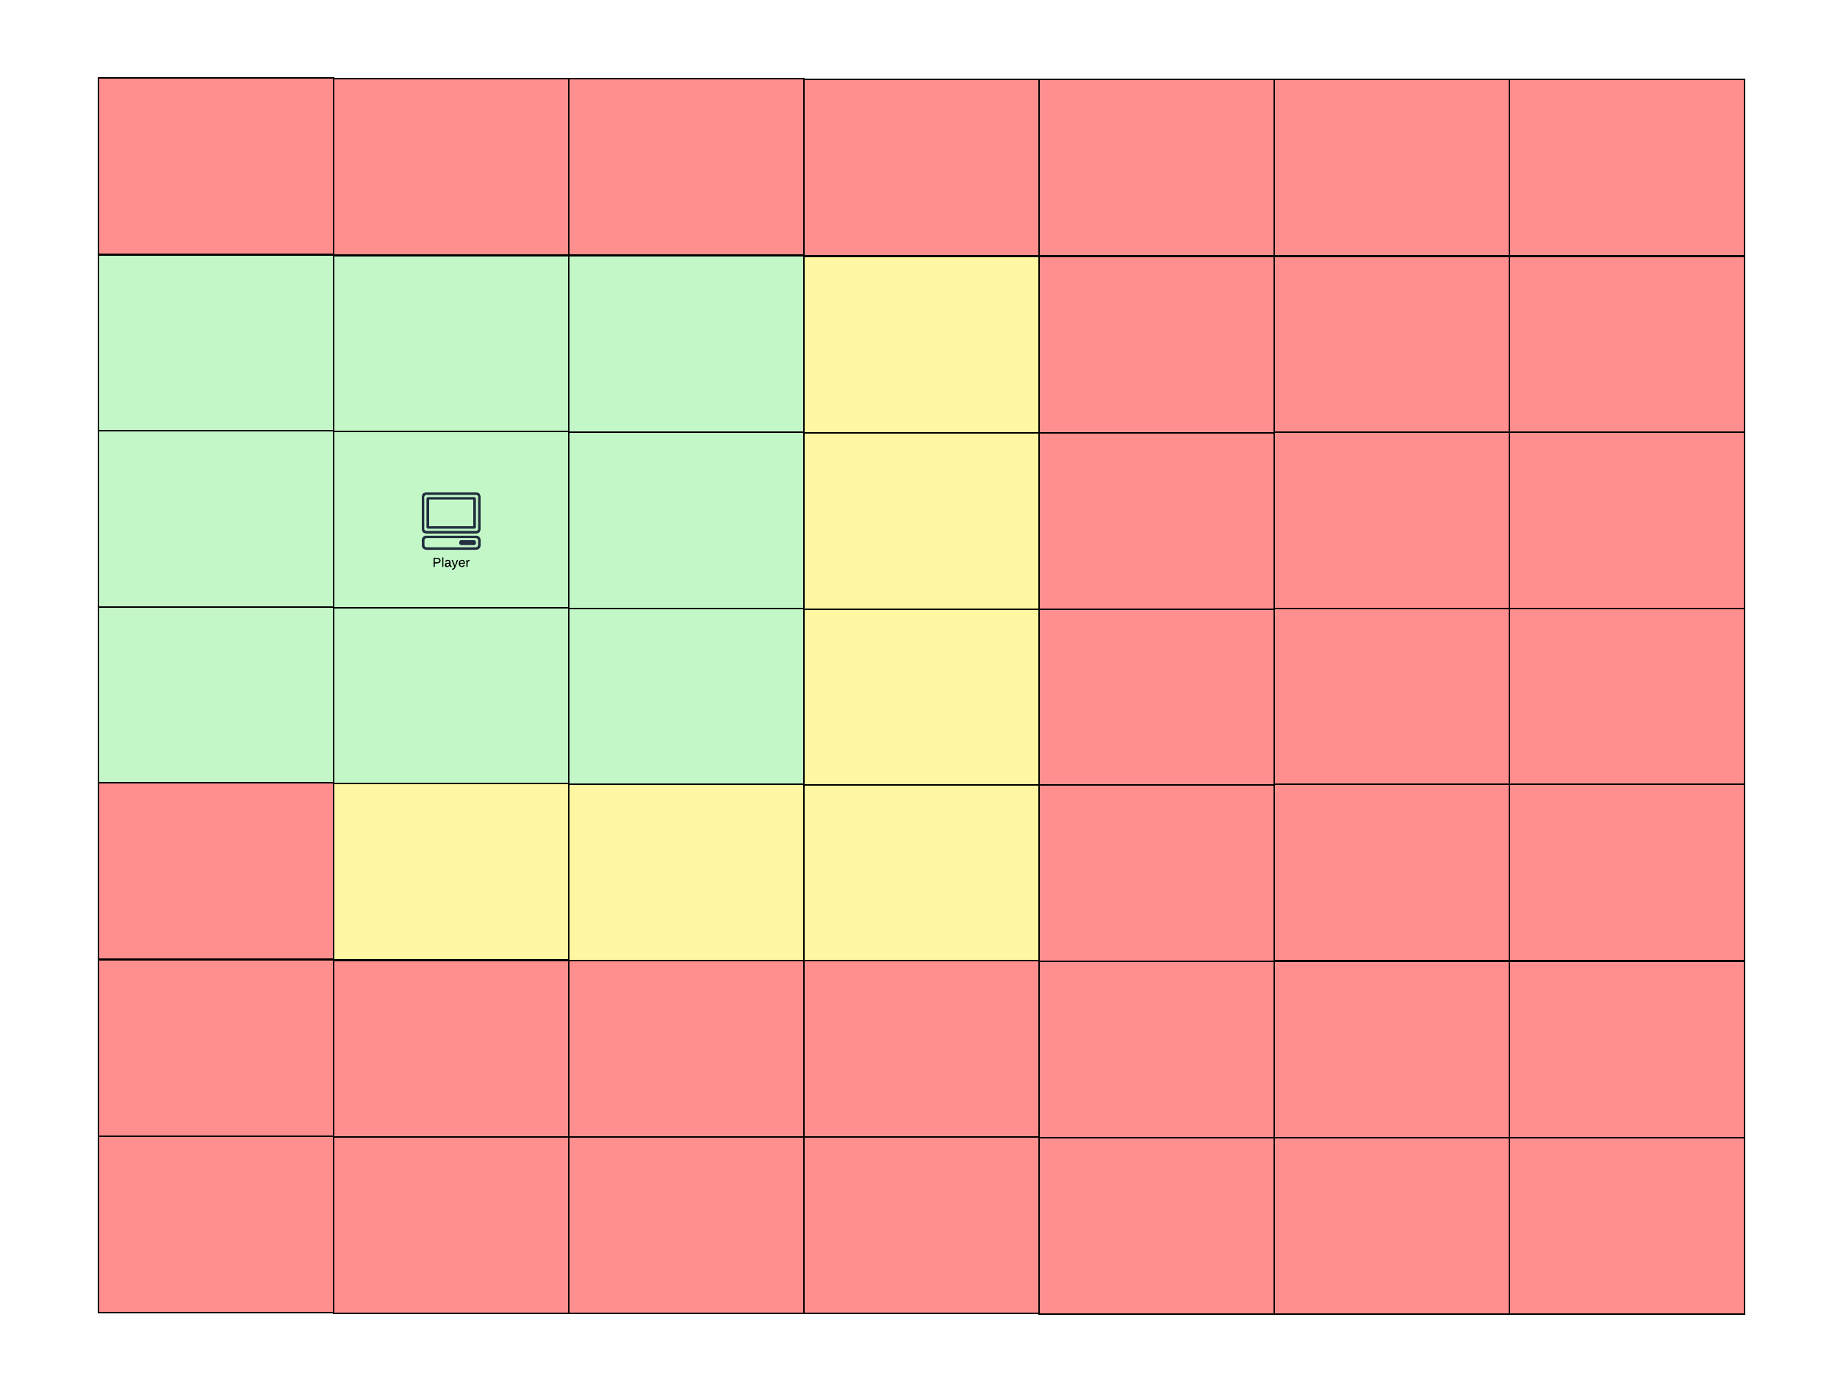
Map Registration Algorithm

Slide 31
Thank You
Kevin Daniel Setiono
kdsbest@gmx.de
Slides and Code: https://github.com/KDSBest/DevCom2022/

